Slide 1
Unemployment In The USA
Rucha Sonawane
Devershi Rathore
Waseem Shah

Slide 2
Why do we care?
Firstly we need to know why the government collect statistics on the unemployed..
It does this for many reasons. Some areas to look at are:
Is the unemployment rate increasing or decreasing?
Is it in just one area or nation wide?
Who is losing their jobs?

Slide 3
Effects of Unemployment
Social Impacts
People tend to communicate less which means not developing your social abilities as a result of not having a job.
Economic Impacts
Unemployed people do not produce goods and services which could contribute millions of dollars of economy.
Example of General Motors company.

Slide 4
Continued…
Political Impacts
Unemployment angers people who eventually blame the government for it and the presidential elections might get affected.
Other Impacts
A high unemployment rate also means that more people will be below the poverty line and more people will be at a risk from infectious diseases.

Slide 5
Project Sponsor
We ourselves we are going to sponsor by utilizing the resource we have.
The school will sponsor us.

Slide 6
Problem statement & Hypothesis
Analyzing the unemployment rates in various years in USA.
Which area needs what kind of empowerment to decrease the unemployment rates.
What are the states, age groups, races of people and gender of the people affected by unemployment.
Comparing and analyzing the unemployment rates in 50 different states of US.

Slide 7
Hypothesis
Initially we all know that unemployment in the United States has been increasing across racial groups.
After considering all the variables in our dataset we have found out the ones that have more significantly affecting the Unemployment rate of year 2016 by applying regression algorithm.
These variables are Unemployment rate of the years 2012, 2014, 2015.
Using this information we can eliminate those variables and improve the Unemployment rate.

Slide 8
Listed Hypothesis:
1. On different age groups.
2. On different Races.
3. On different States in the USA.
4. On number of Men and Women:

Slide 9
Data source & Data Processing
Will have obtained the Dataset from the United States Department of the Bureau of labor website which is significant and reliable.

Slide 10
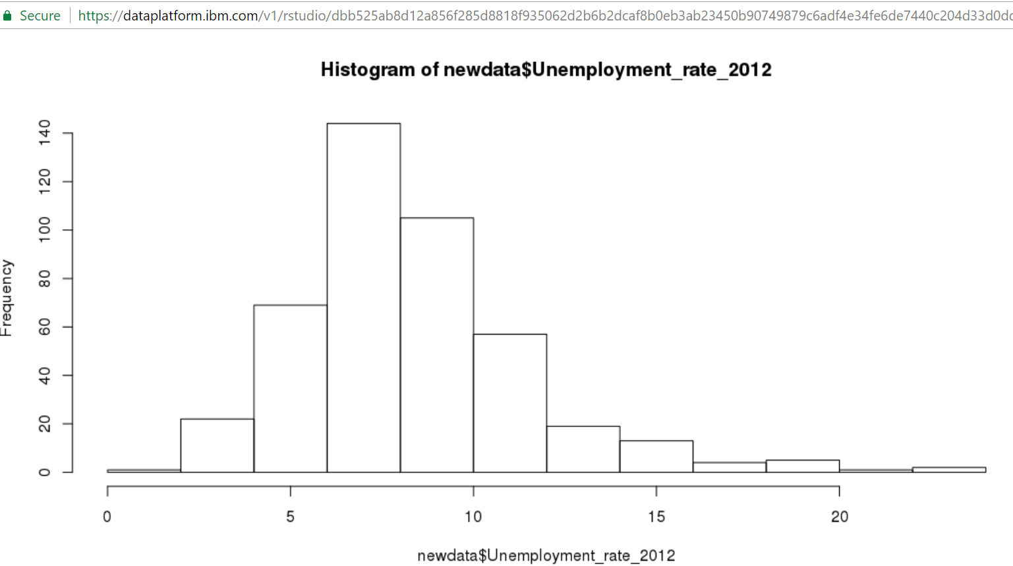
Output Screenshots and Gained Analysis Histogram of unemployment rate in 2012 after performing regression

Slide 11
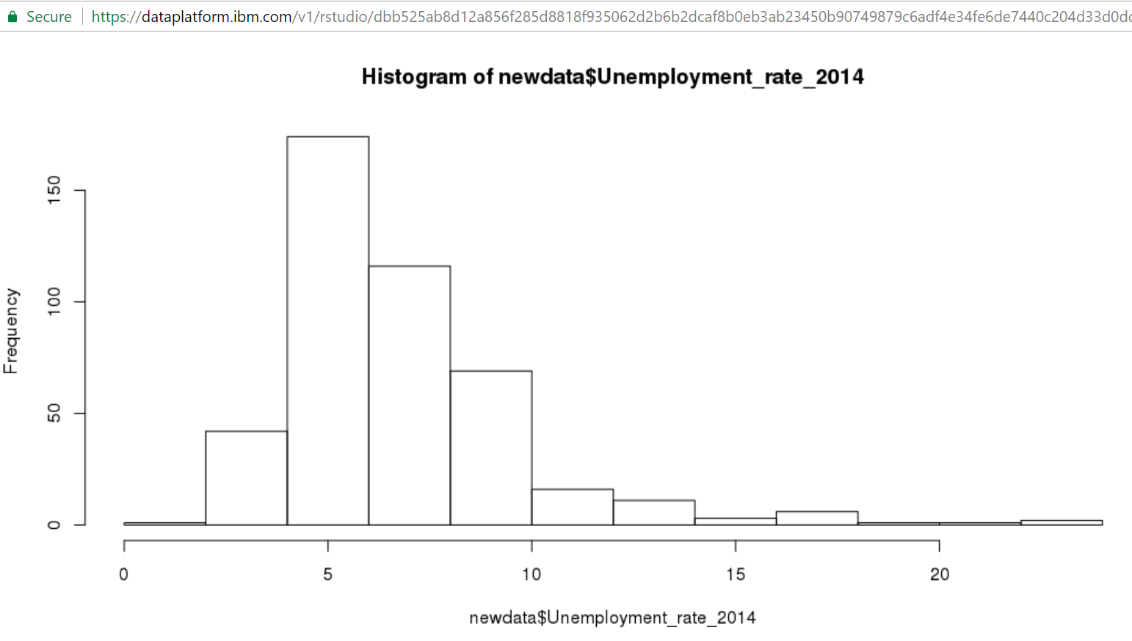
Histogram of unemployment rate 2014

Slide 12
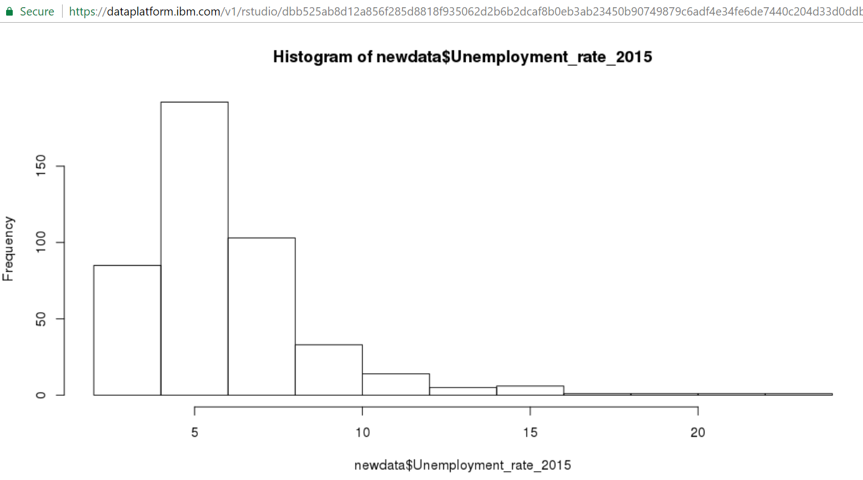
Unemployment rate of 2015

Slide 13
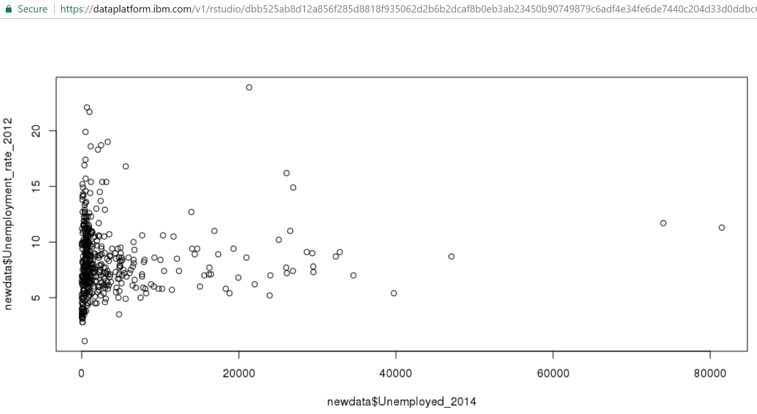
Scattered plot of unemployment rate in 2012 vs 2014

Slide 14
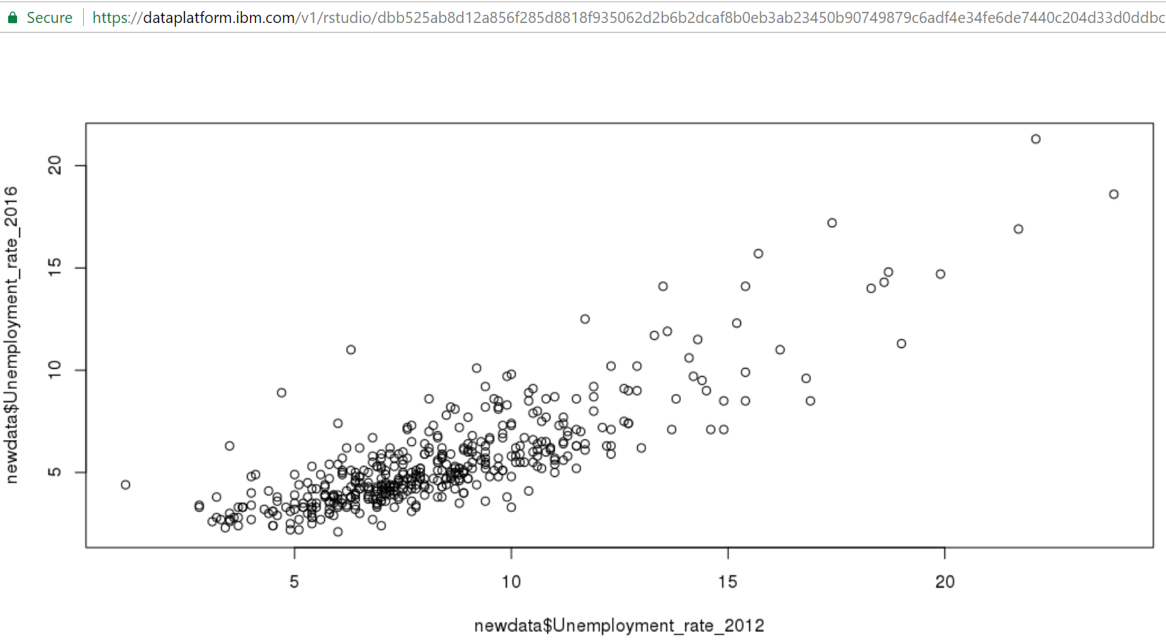
Scattered plot of unemployment rate in 2016 vs 2012

Slide 15
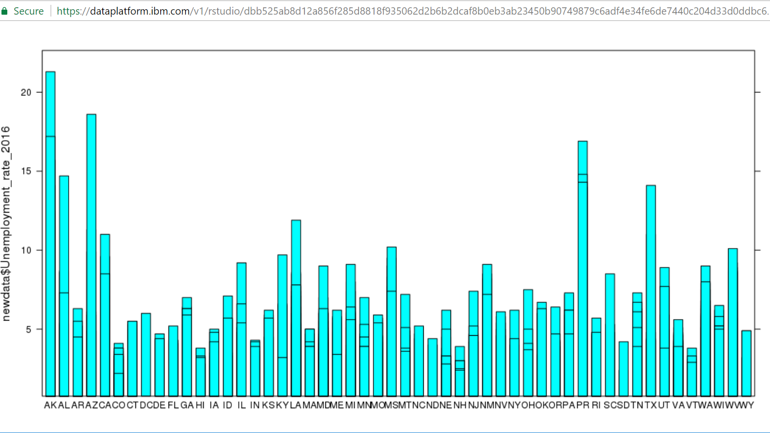
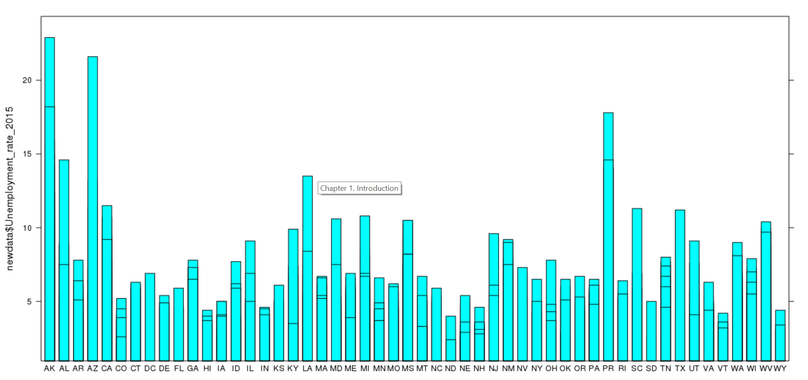
The below graph represents the employment rates in various States across USA. This helps us to understand which states (AK, AZ, PR) are facing more unemployment issues every year and accordingly can be provided more facilities.

Slide 16
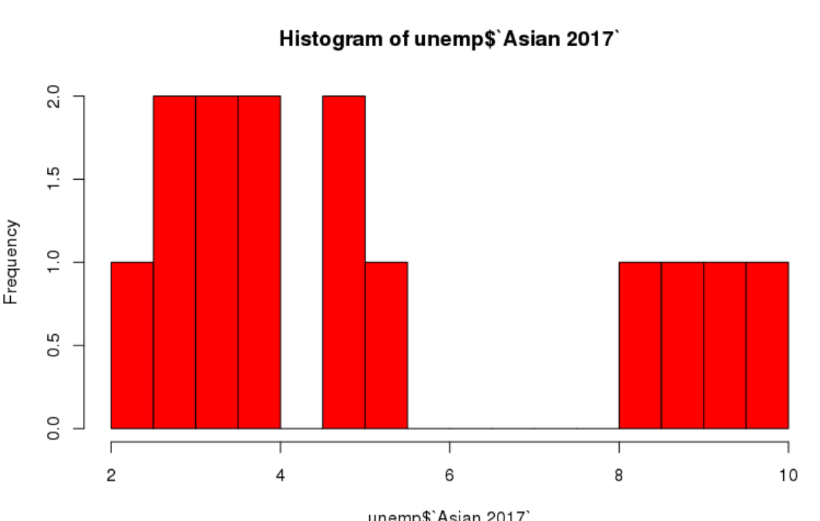
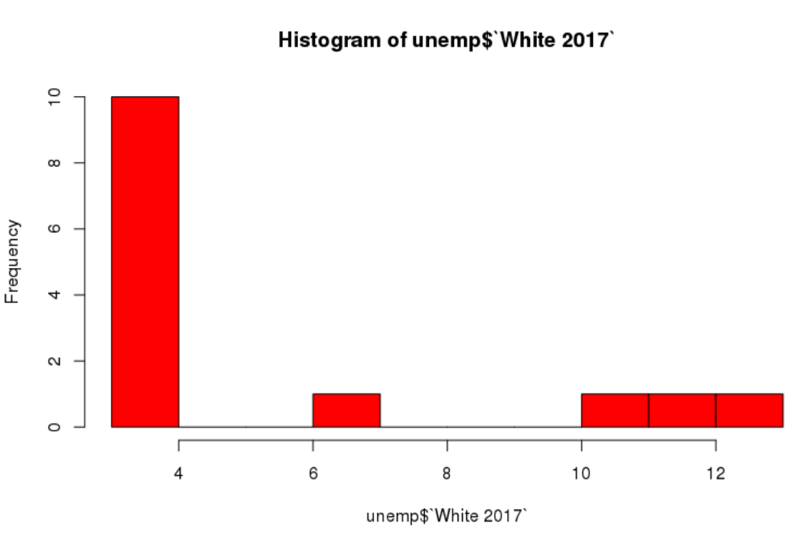
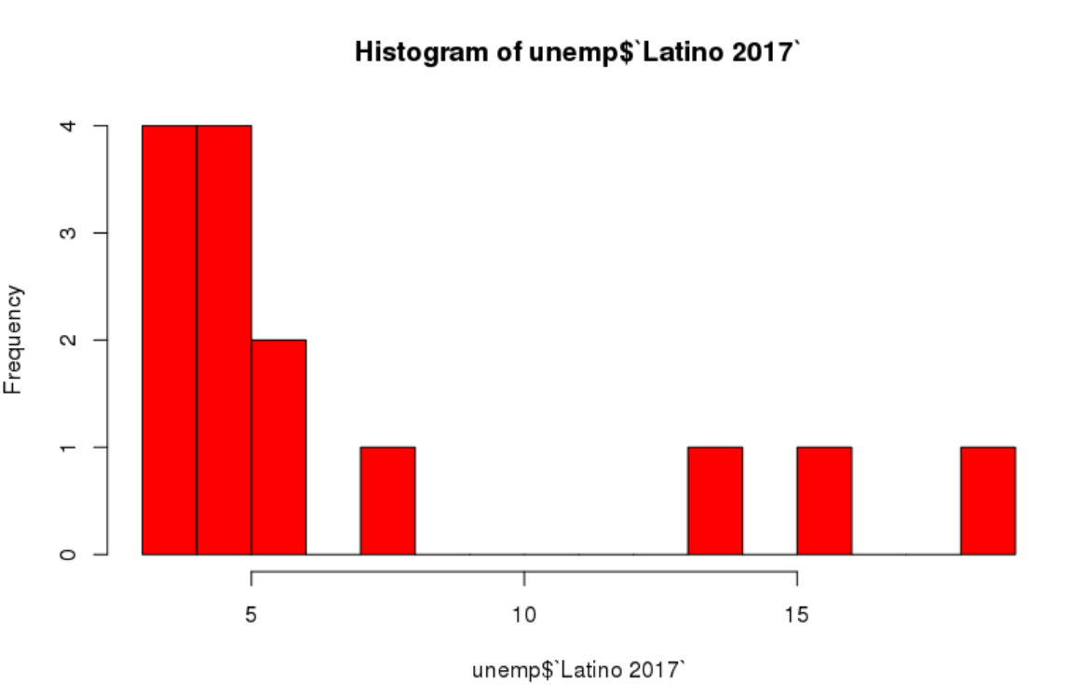
Also the analysis of unemployment amongst people of different races is performed using another dataset that helps us to understand the impact of people of various races on unemployment amongst native American people:

Slide 17
If given more Time and Resources
We could study and forecast the Unemployment Rate by Neural Networks Using Search Engine Query Data.
If we were given more time for the project we could go to the field to collect the data on our own additional variables and parameters
Applying advanced data mining techniques, we could generate set of rules to analyze factors contributing to the job opportunity success in the industry.

Slide 18
References and Publications
Databases, Tables & Calculators by Subject.(2017)Bls.gov.:
Retrieved from https://www.bls.gov/data/#unemployment
IBM Data Science Experience - Watson Data Platform Learning:
https://developer.ibm.com/clouddataservices/docs/ibm-data-science-experience/
“Forecasting the Unemployment Rate by Neural Networks Using Search Engine Query Data”- 2012 45th Hawaii International Conference on System Sciences
Job Opportunity Factors using decision trees:
https://static.secure.website/wscfus/8466857/3078480/v6n4p8-cisdiar-journal-job-opportunity-factors-analysis-using-decision-tree-algorithms.pdf

